Slide 1

A Project Report on
Machine Learning Techniques for Accurate Flight Delay Forecasting
submitted in the partial fulfillment of the requirements for the award of the degree of
BACHELOR OF TECHNOLOGY
In
COMPUTER SCIENCE AND ENGINEERING
By
Devangam Harathi 212G1A0571
Shaik Sohail 222G5A0514
Madiga Shireesha 212G1A0594
K. Kiran Kumar 212G1A0591
V. Adi Keshava Reddy 212G1A05C1
V. Pradeep Kumar Naik 212G1A05B9
Under Supervision of
Dr. K. BHARGAVI _{M.Tech, Ph.D}
Associate Professor & HOD, Department of Computer Science and Engineering
ANANTHA LAKSHMI INSTITUTE OF TECHNOLOGY AND SCIENCES
Approved by AICTE, New Delhi & Affiliated to J.N.T.U. Ananthapuram, Accredited by
NAAC Near S.K. University, Itikalapalli(V), Anantapur (Dt) – 515 721.A.P.

Slide 2
CONTENTS
1. Abstract
2. Introduction
3. Existing Systems
3.1 Disadvantages
4. Proposed Systems
4.1 Introduction
4.2 Objectives
4.3Flight delay prediction model
4.4 Advantages
4.5 Software and Hardware Requirements
4.6 System Architecture
5. System Design
5.1 DFD Diagram
5.2 Use Case Diagram
5.3 Sequence Diagram
6. Test cases
7. Results
8. Conclusion
9. References

Slide 3
1. ABSTRACT
Flight delays pose critical challenges to the aviation industry, impacting passengers, airline operations, and regional economies.
This project introduces a flight delay prediction system that applies various machine learning algorithms to historical flight data. The objective is to accurately forecast potential delays and evaluate the performance of models such as Logistic Regression, Decision Trees, Random Forest, and Gradient Boosting.
By analyzing real-world datasets, the system provides airlines with tools to improve operational planning, enhance passenger satisfaction, and reduce delay-related costs.

Slide 4
2. INTRODUCTION
Flight delays have become a significant challenge for passengers, airlines, and airports, impacting both efficiency and economics. According to the Bureau of Transportation Statistics, approximately 20% of commercial flights are delayed.
This project leverages machine learning techniques to predict flight delays more accurately than traditional statistical methods. By analyzing historical flight data—including schedules, weather, and traffic conditions—we compare models like Logistic Regression, Decision Tree, Random Forest, and Gradient Boosting to determine the most effective predictors.
Our goal is to provide a scalable, real-time system that enhances flight planning, minimizes delays, and improves passenger experience.

Slide 5
3.EXISTING SYSTEMS
Uses basic statistical models like Linear Regression and Time-Series Analysis.
Involves manual delay management and basic scheduling tools.
Relies on limited data (e.g., scheduled times, historical delays).
Lacks predictive intelligence for proactive decisions.
3.1 Disadvantages of Existing Systems:
Limited Feature Scope: Ignores weather, traffic, and operational data.
Reactive in Nature: Deals with delays after they happen.
Low Accuracy: Struggles with complex relationships in flight data.
Outdated Methods: Depends on basic models like Decision Tree & Logistic Regression.

Slide 6
4. PROPOSED SYSTEMS
4.1 Introduction
Utilizes advanced Machine Learning algorithms to forecast flight delays.
Trained on a comprehensive dataset from the U.S. Bureau of Transportation Statistics (2019).
Incorporates diverse features such as:
Weather conditions
Flight schedule data
Airport traffic
Airline-specific performance
Supports real-time prediction and proactive decision-making for airlines and passengers.
Enhances accuracy, scalability, and efficiency compared to traditional systems

Slide 7
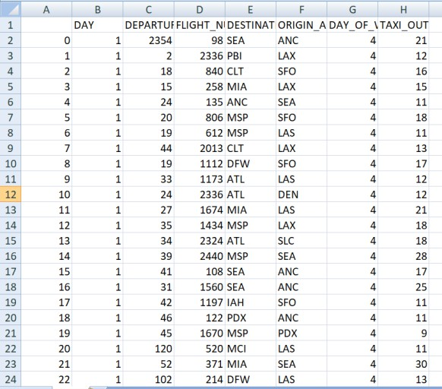
4.2 Objectives
To minimize flight delays and cancellations using predictive analytics.
To forecast delays based on historical and real-time flight attributes.
To assist airlines in optimizing flight schedules and resource management.
To provide passengers with timely and reliable delay predictions.
To develop a scalable and accurate prediction system using supervised machine learning models.
4.3 Flight delay prediction model:
Implements a structured approach using machine learning algorithms.
Flight Delay Data
The process begins by collecting real-world flight data from the official US BTS database, which includes details like schedule times, delays and more.

Slide 8
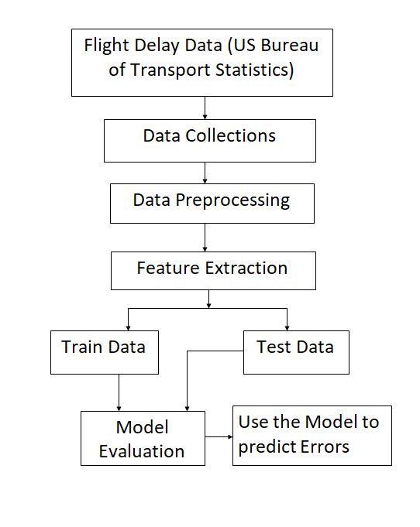
Data Collections
Gathering and aggregating relevant features from multiple sources such as flight history, weather reports, and airline schedules.
Data Preprocessing
Cleansing raw data by:
Removing missing values
Handling outliers and duplicates
Normalizing or standardizing feature
Feature Extraction
Selecting important inputs (features) that impact delay prediction:
Date, airline, airport, time of day
Taxi-out time, day of week, weather

Slide 9




Train Data / Test Data Split
Dataset is divided into:
Training Set – used to teach the model
Testing Set – used to evaluate model accuracy
Typically, 80% for training and 20% for testing.
Model Evaluation
The trained model is tested using the test data and evaluated using:
Confusion matrix: The confusion matrix is a table that summarizes the performance of a classification model by comparing actual and predicted values
 | Actually Positive(1) | Actually Negative(0)
Predicted Positive(1) | True Positives (TPs) | False Positives (FPs)
Predicted Negative(0) | False Negatives (FNs) | True Negatives (TNs
Accuracy metrics:
Accuracy: Represents the percentage of correctly predicted instance
Precision: Measures how many of the predicted positive cases were actually correct
Recall: Measures how many actual positive cases were correctly identified.
F1-Score: Balances precision and recall in a single metric

Slide 10
4.4 Advantages
Higher Accuracy
Real-Time Predictions
Scalable Solution
Better Passenger Experience
Automation & Efficiency
4.5 Software and Hardware Requirements
Hardware Requirements:
System : Intel Core i7.
Hard Disk : 1TB.
Monitor : 15’’ LED
Input Devices: Keyboard, Mouse
Ram : 16GB.
Software Requirements:
Operating system :Windows 10.
Coding Language :Python
Tool :Py Charm, Visual Studio Code
Database :SQLite3

Slide 11
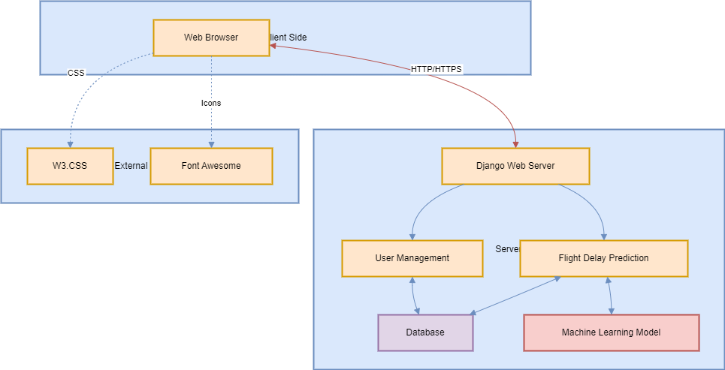
4.6 System Architecture
Client Side: Web browser acts as the UI.
Uses W3.CSS for styling and
Font Awesome for icons. Sends data via
HTTP/HTTPS.
Server Side (Django): Handles user actions and predictions through:
User Management – Manages login/register using the database.
Prediction Module – Sends data to the ML model for delay
predictions.
Database: Stores user details and flight data.
ML Model: Predicts delays using trained historical data.

Slide 12
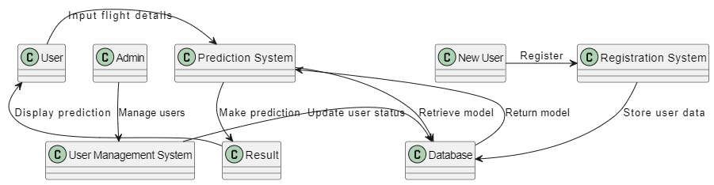
5. SYSTEM DESIGN
5.1 DFD Diagram
A Data Flow Diagram (DFD) :is a visual representation of how data moves through a system.
It shows:User inputs flight details and views predicted outcomes.
Admin manages users via the User Management System
Prediction System processes inputs, interacts with:
Result component to show predictions.
Database to retrieve the ML model.
New User registers via the Registration System, which stores data in the Database.
The Database stores user info and machine learning models used for predictions.

Slide 13
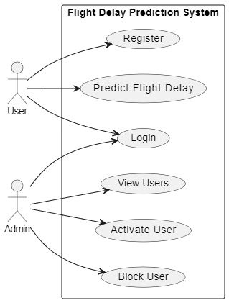
5.2 Use Case Diagram
A use case diagram is a visual representation that shows the interactions between users (actors) and a system to capture its functional requirements.
Actors:
User
Admin
User Use Cases:
Register: Sign up to create an account.
Login: Log in to access the system.
Predict Flight Delay: Enter flight details to get delay prediction.
Admin Use Cases:
Login: Access admin panel.
View Users: See all registered users.
Activate User: Approve user accounts.
Block User: Restrict access for specific users.

Slide 14
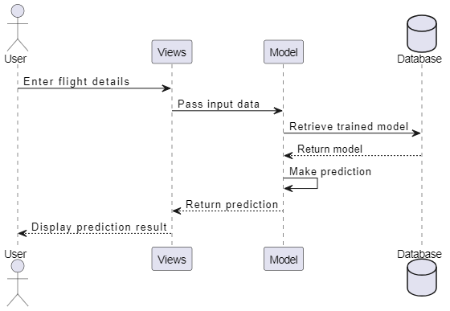
5.3 Sequence Diagram
This sequence diagram illustrates the interaction between the user and the system for predicting flight delays:
User enters flight details through the interface.
Views component receives the input and forwards it to the Model.
Model retrieves the trained model from the Database.
The model processes the input and makes a prediction.
The prediction result is sent back to the Views.
Views then display the prediction result to the User

Slide 15
6. TEST CASES
Test Case No. | Test Scenario | Test Steps | Expected Outcome
1 | Valid Input Data | 1. Input valid data for all fields (e.g., FL_DATE, TAIL_NUM, CRS_DEP_TIME). | Form should submit successfully and display prediction result.
 |  | 2. Submit the form.
2 | Invalid Flight Date | 1. Input an invalid or future date for FL_DATE. | The form should reject submission and show an error message like "Invalid date."
 |  | 2. Submit the form.
3 | Missing Required Fields | 1. Leave some required fields (e.g., OP_UNIQUE_CARRIER) blank. | Error messages should indicate missing fields, and no prediction is made.
 |  | 2. Submit the form.
4 | Predicting for Cancelled Flight | 1. Set CANCELLED to 1. | The system should display a message like "Flight is canceled," and no prediction is made.
 |  | 2. Fill other fields with valid data.
 |  | 3. Submit the form.
5 | Invalid Airport ID | 1. Input invalid data for ORIGIN_AIRPORT_ID or DEST_AIRPORT_ID. | Error message should display "Invalid Airport ID."
 |  | 2. Submit the form.
6 | Valid Flight Number Format | 1. Input a valid numeric flight number in OP_CARRIER_FL_NUM. | Form should submit successfully, and a prediction should be displayed.
 |  | 2. Submit the form.

Slide 16
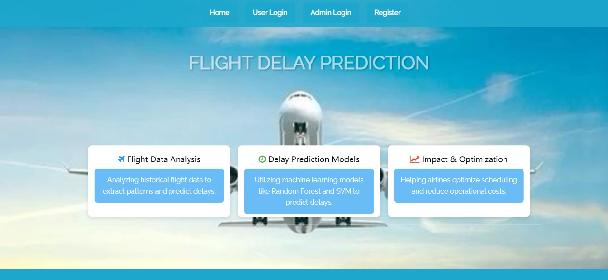
7. RESULTS:
Fig 7.1 Home Page

Slide 17
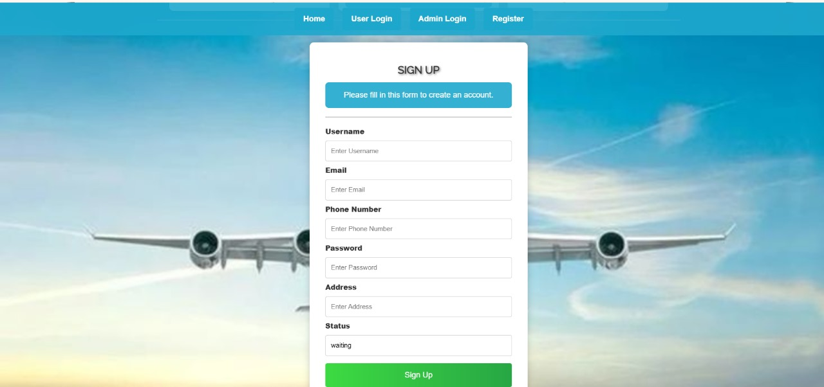
Fig 7.2 User Registration Page

Slide 18
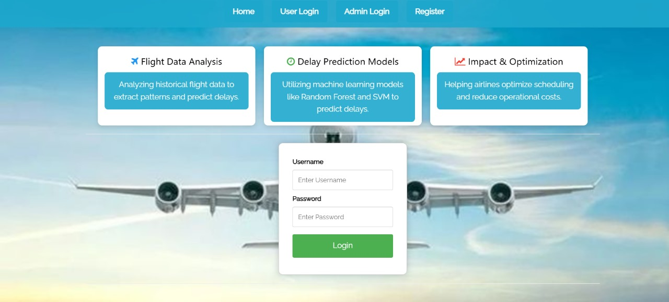
Fig 7.3 User Login Page

Slide 19
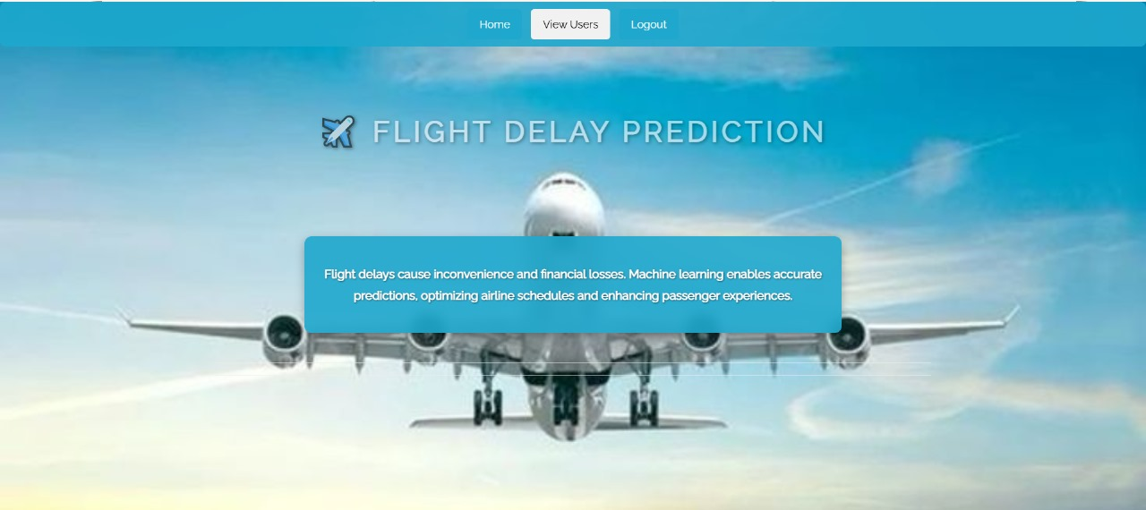
Fig 7.5 Admin Home Page

Slide 20

Fig 7.6 Fig. User Home Page

Slide 21

Fig 7.7 Training Result Page

Slide 22
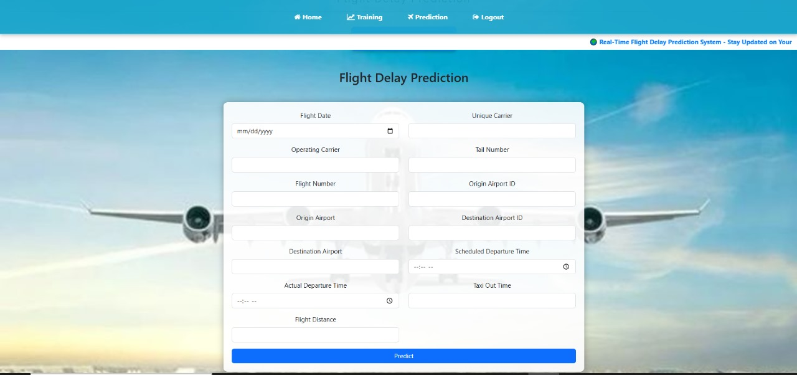
Fig 7.8 Flight Delay Prediction Page

Slide 23
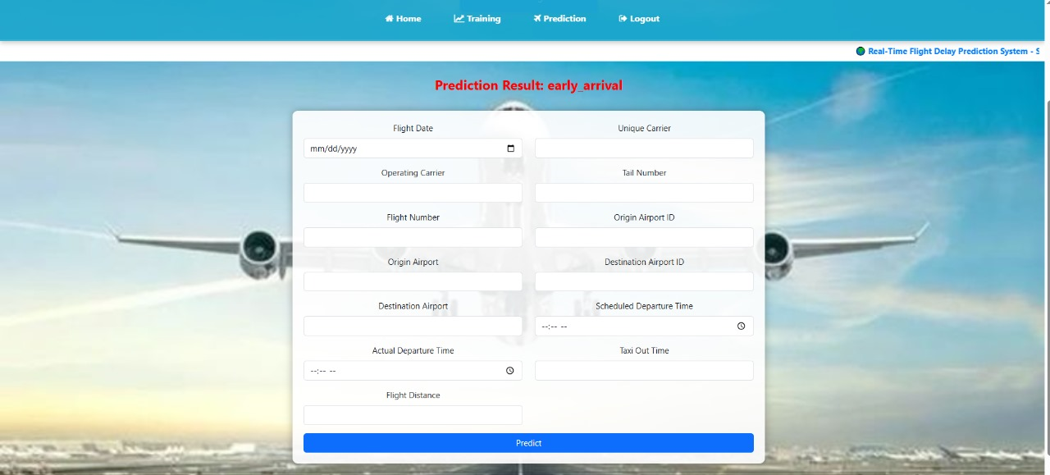
Fig 7.9 Prediction Result

Slide 24
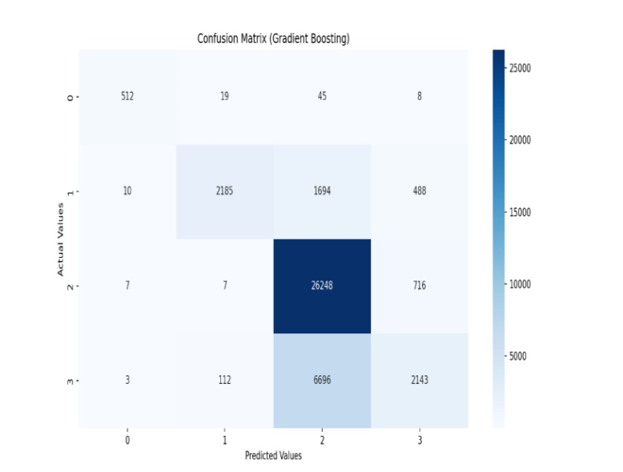
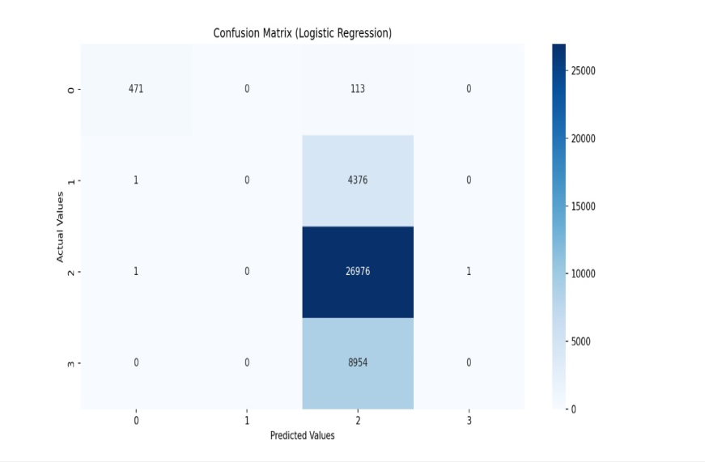
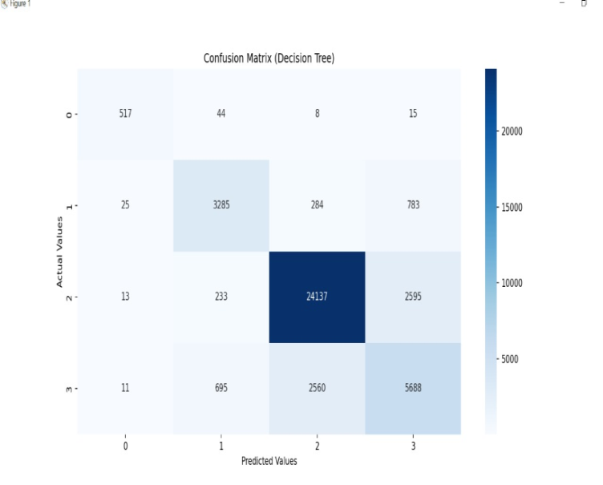
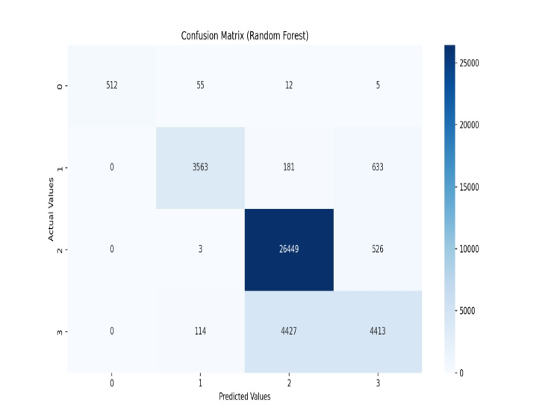
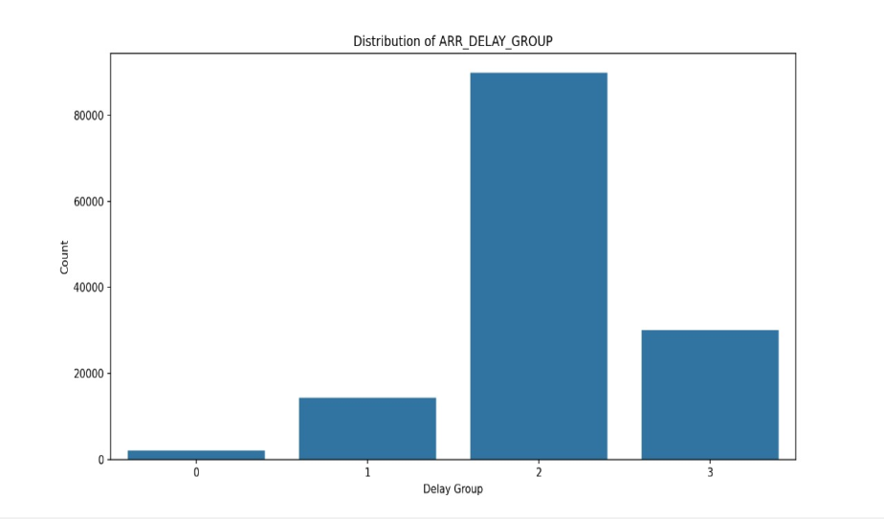
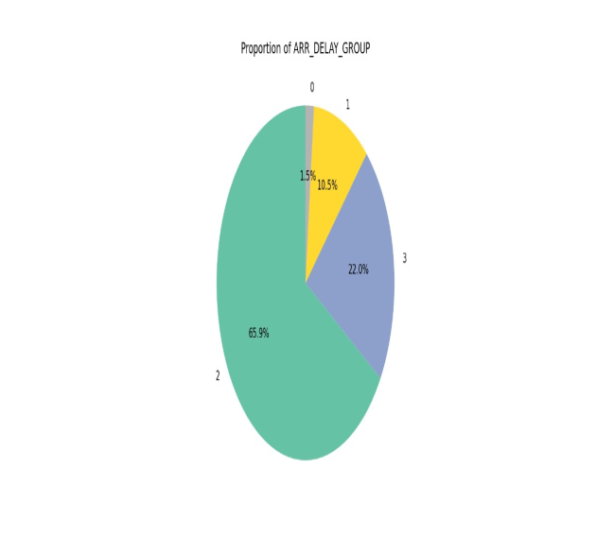
Graphs

Slide 25
8.CONCLUSION
Developed a machine learning-based system to predict flight delays accurately.
Implemented and evaluated multiple models to improve prediction performance.
Built a user-friendly interface using Django for real-time predictions.
Helps airlines and passengers plan better and reduce uncertainty.
Future work includes adding more features and optimizing model accuracy further.

Slide 26
9. REFERENCES
[1] Borse, Y., Jain, D., Sharma, S., Vora, V., and Zaveri, A. (2020) Flight Delay Prediction System. International Journal Of Engineering Research & Technology (IJERT) Volume 09, Issue 03 (March 2020).
[2] Bureau of Transportation Statistics. Available online: https://www.bts.gov/ (accessed on 26 March 2020).
[3] Akpinar, M.T. and Karabacak, M.E. (2017). Data mining applications in civil aviation sector: State-of-art review. In CEUR Workshop Proc (Vol. 1852, pp. 18-25).
[4] Nazeri, Z. and Zhang, J. (2017). Mining Aviation Data to Understand Impacts of Severe Weather. In Proceedings of the International Conference on Information Technology: Coding and Computing (ITCC.02) pp. 518-523.
[5] Ha. ,. J. N. a. H. P. S. Man. (2015) "Analysis of Air-Moving on Schedule Big Data based on Crisp Dm Methodology," ARPN Journal of Engineering and Applied Sciences, pp. 2088-2091.
[6] Mukherjee, A., Grabbe, S. R., and Sridhar, B. (2014). Predicting Ground Delay Program at an airport based on meteorological conditions. In 14th AIAA Aviation Technology, Integration, and Operations Conference (pp. 2713-2718

Slide 27
THANK YOU

